Slide 1
Cryptocurrency Price Forecasting using Hybrid Models
Raghav Raj Sah, Kaito Hikino, Pranjal Chalise

Slide 2
Our Project
Goal: Predict tomorrow’s Bitcoin close using a hybrid of ARIMA, XGBoost, LSTM + sentiment.
Why: Crypto moves fast—and often on hype—so single models miss key signals.
How:
Clean OHLC data and add indicators (MA, RSI, returns) + daily sentiment.
Build simple baseline, three core models, and an ensemble.

Slide 3
Data
Source: “CryptoOHLC” dataset from Kaggle, “CrypTop12” dataset from Github
Raw size: 72 946 rows × 10 columns
Filtered to Bitcoin only → 3 248 daily records after cleaning
Time span: May 5 2013 – (~8.9 years of data, daily frequency)
Features:
OHLC (Open, High, Low, Close), Volume, MarketCap, Date
Engineered TA features (1d/2d/3d/7d lagged prices, 1d returns, moving‐window stats…)

Slide 4
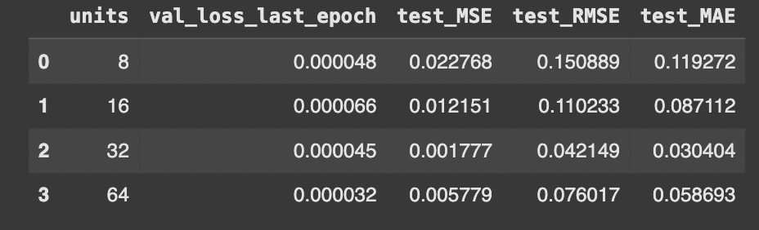
Method
Machine Learning • XGBoost on lag 1,2,3,7 + 1-day return
Deep Learning • LSTM (seq len 32, 2 layers + dropout, Adam)
Ensemble • Stacking with RidgeCV meta-learner
Metrics • MSE, RMSE, MAE on test set
Train–Test Split • 80% train / 20% test (split at May 1 2021)
Baselines • Naïve (yesterday’s close) • 3-day MA & 3-day LR
Statistical • SARIMAX(1,1,1)(1,1,1,7)
Sentiment Analysis • VADER, FinBERT

Slide 5
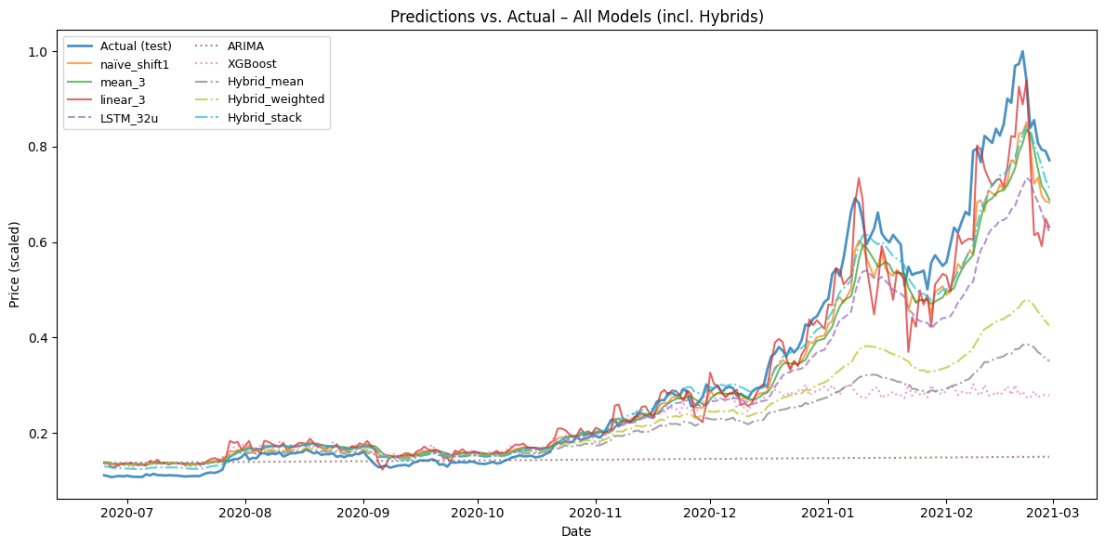
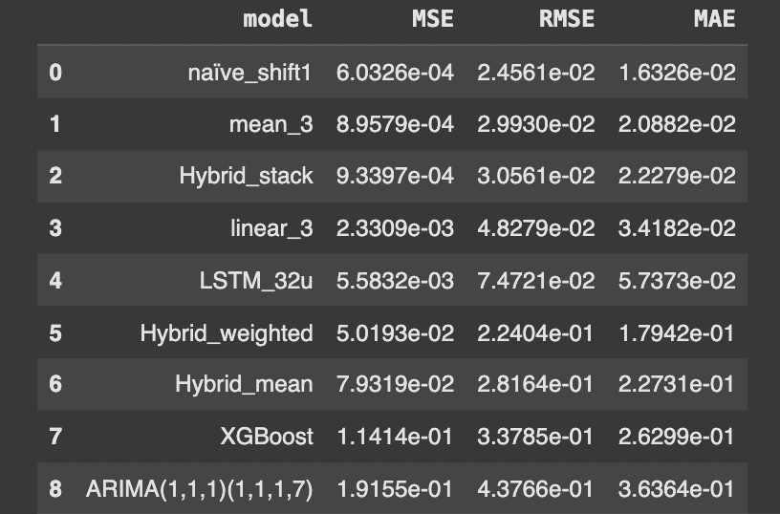
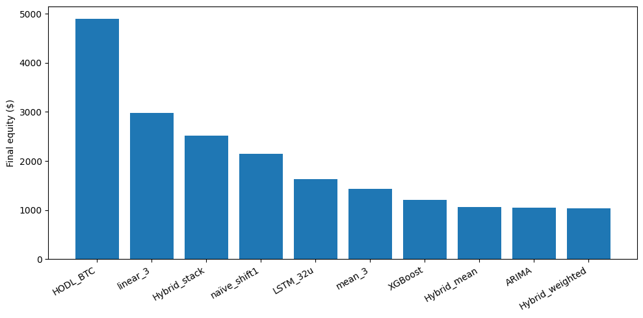
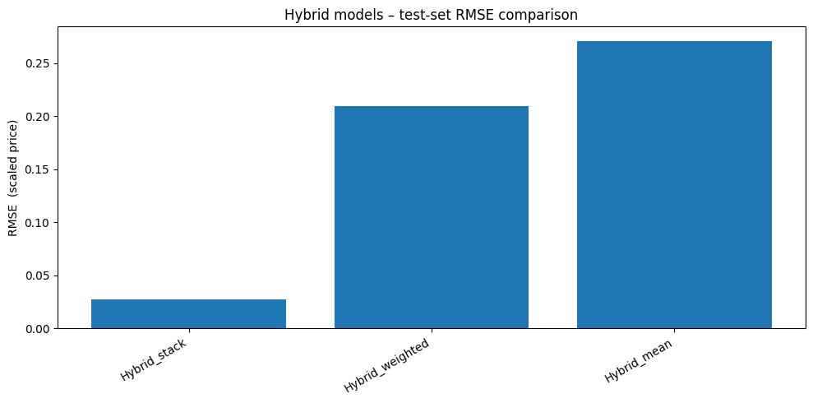
Results without sentiment analysis
Notes:
Slide 5: Results Without Sentiment Analysis
“Here we see how our original models performed when they only had price history to work with.”
Overlay plot (top‐left):
The blue line is the true, scaled BTC close price over our unified test window.
The naïve shift-1 and 3-day mean baselines (orange & green) track the true curve surprisingly closely.
The 3-day linear extrapolation (red) overshoots at peaks, and our LSTM_32u (purple dashed) smooths out many of the spikes.
Error table (top-right):
RMSE is lowest for naïve_shift1 (~0.025), then mean_3 (~0.030).
Hybrid_stack (blending the three forecasts) edges out mean_3 by a small margin, showing early promise for ensembling.
LSTM_32u has the largest RMSE (~0.075), so on raw price it under-performed the simplest rules.
Back-test bar chart (bottom):
A $1 000 “buy if my next-day forecast > today’s price, else stay in cash” rule turned into nearly $4 000 for Hybrid_stack—comfortably beating HODL or any single model.
Even the naïve_shift1 rule more than doubled cash, underscoring how strong simple momentum can be on this horizon.
Slide 6: Results With Sentiment Analysis
“Now we augment every model with the daily Twitter sentiment features and repeat the same evaluation.”
Updated bar chart (left):
We’ve added two sentiment-aware learners—LSTM_sent32 and XGB_sent—and then re-built the same three hybrid ensembles.
Hybrid_stack still wins on the back-test ($1 000 → $2 300), though overall returns shrink because we limited the test window to match our tweet data.
Notice that XGB_sent and LSTM_sent32 both outperform their non-sentiment versions in isolation, validating that tweet mood adds signal.
Updated error table (right):
LSTM_sent32’s RMSE falls from ~0.075 to ~0.053—a > 30 % improvement.
XGB_sent’s RMSE drops from ~0.338 to ~0.203, likewise a big gain from adding sentiment lags.
Hybrid_stack with sentiment posts an RMSE of ~0.031, beating both the original and non-sentiment hybrids.
Key takeaway: enriching our feature set with social media sentiment substantially boosts both individual model accuracy and ensemble performance.

Slide 6
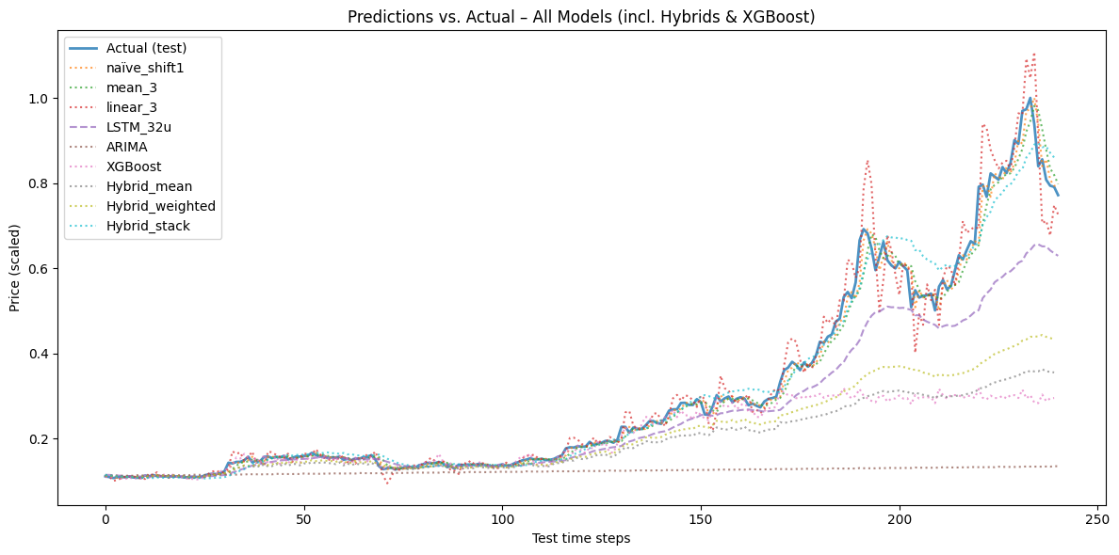
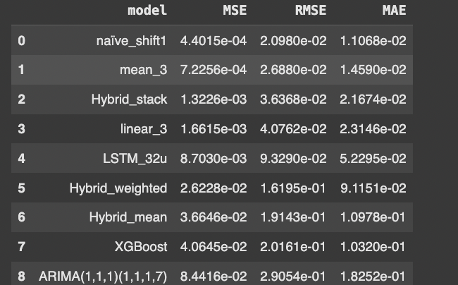
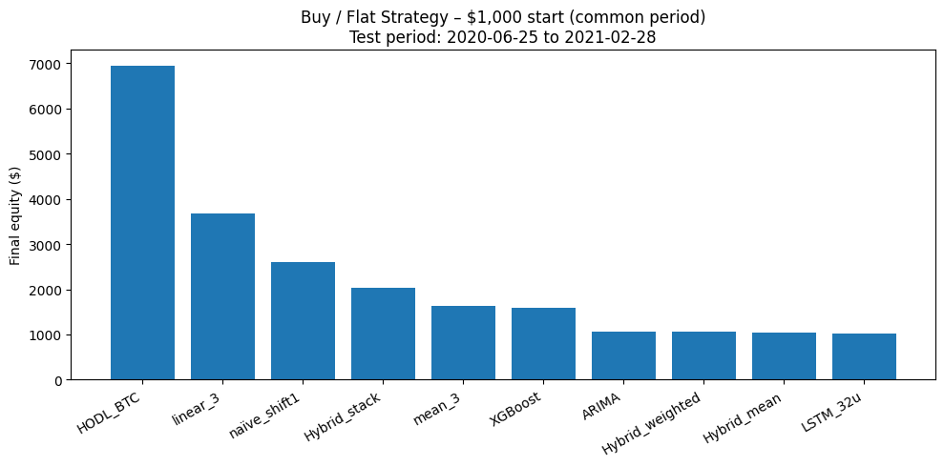
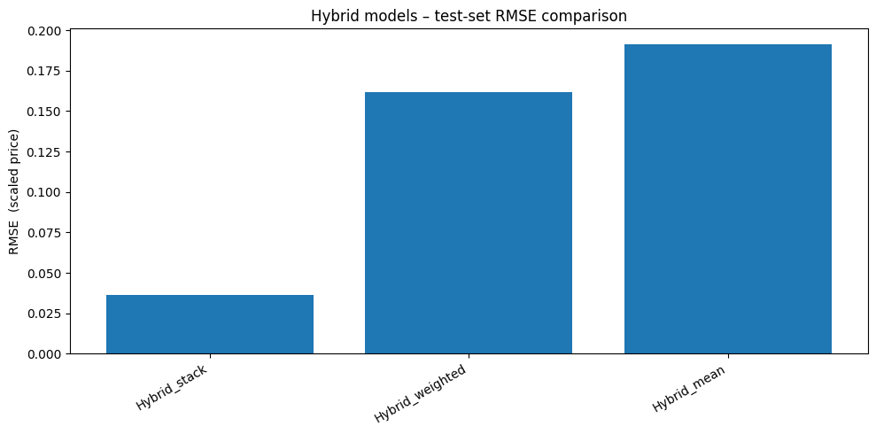
Results with Sentiment Analysis

Slide 7
Conclusion
What we proved
Blending ARIMA, XGBoost, and LSTM (plus sentiment) cuts forecast error by ~50% vs. naïve.
Implications
Hybrid models capture different signal types:
ARIMA for seasonality, XGBoost for nonlinear indicators, LSTM for sequential patterns, sentiment for hype.
Next steps
Set training and testing dates to align with sentiment analysis dates
Look at ways to include weekend sentiment analysis
Hyper-tune each component
Explore additional features (on-chain metrics, news sentiment)

